Slide 1
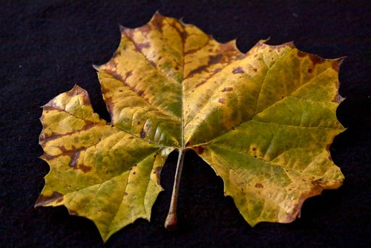
Will it reduce the bacterial and fungal infections?
How automated system identify different disease on plants
Whether it will give high quantity and quality
They can find the disease at the early stages
How deep learning techniques work on plants?
Recommendation of fertilizer
They have plenty of recommendation
Interactive user interface to upload images
They find the disease by taking the photo of the leaves
Portal for farmers
Disease identification
This is very much user friendly
Purchase fertilizer based on the recommendation
Farmers need recommendation based on the disease
Recommend the web app to other farmers
It is simple to use
Internet is needed
New disease arise
Easy identification of disease
Minimum risk
Not organic
Spending large amount of money for fertilizers
Determining best fertilizers
Prevention of disease

